Slide 1


CSE 470/598 Computer Graphics
Ross Maciejewski
rmacieje@asu.edu

Slide 2
Disclaimer
These slides can only be used as study material for the class 470 at ASU
The slides cannot be distributed or used for another purpose

Slide 3
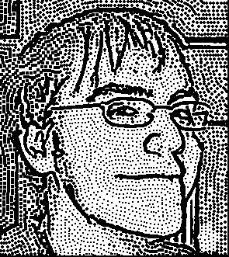
Class Time and Location
Class Time: T R 9:00 – 10:15 AM
Class Location: BYAC 150
Office Hours (BYENG 344): T 2:30PM – 4:00PM
Please send an email if you intend to come to office hours
I try to be flexible, so you can also setup a different meeting time per email
E-mail: rmacieje@asu.edu

Slide 4

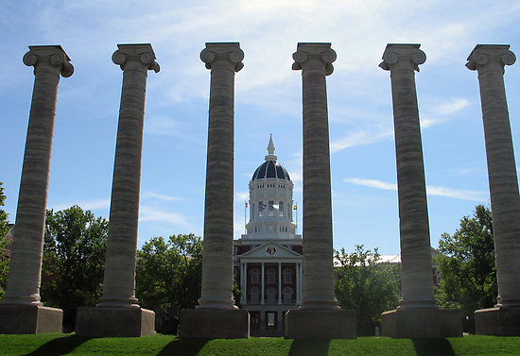

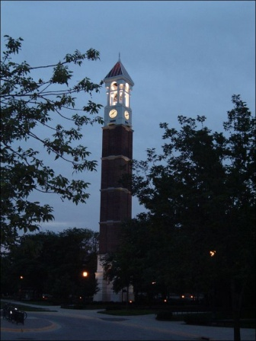
My Background
Before ASU
University of Missouri – Columbia, MO
Purdue University – West Lafayette, IN
Education
PhD/MS in Computer Engineering – Purdue University
BS in Computer Science, Electrical Engineering and Computer Engineering – University of Missouri

Slide 5
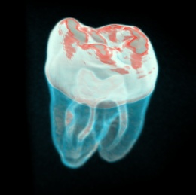
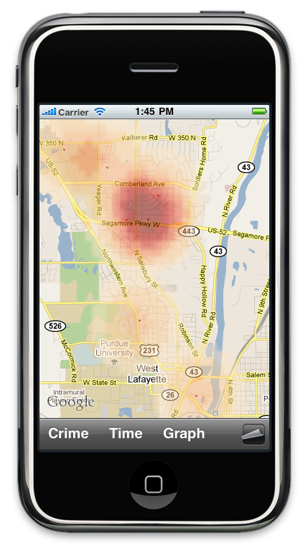
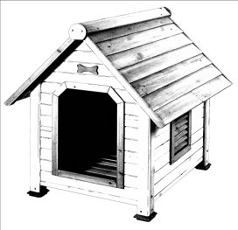
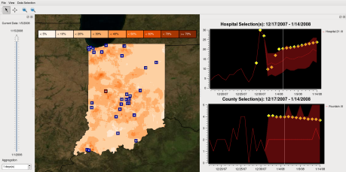
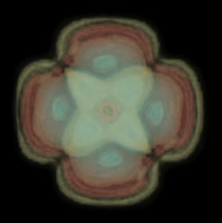
My Research
Visual Analytics
Information Visualization
Visualization
Computer Graphics
Healthcare Analytics
Crime Analytics

Slide 6
Teaching Assistant
Wen Zhang
Office Hours:
Will be announced next week
You can also setup a meeting time outside of the office hours via email
Email: TBA
Wen will primarily be assisting with the projects. Please ask him for questions about implementation and OpenGL.

Slide 7
Class Information
Class uses blackboard/myASU interface:
Syllabus
Slides
Homework
Projects
Announcements

Slide 8
Assignments
Requirements
Individual work (no collaboration)
ASU lab computers or home computers
C/C++ code
Windows
Must compile (or failing assignment)
Submission
Electronic: ASU Blackboard
Source code, data files, executable

Slide 9
Late Policy
No late homeworks are accepted
Assignment due dates and times are posted on blackboard
Assignments are long, be prepared!

Slide 10
Exams
Closed-book
Fixed duration
Mid-term exam
Tuesday, October 10 (tentative), 9:00AM – 10:15 pm, BYAC 150
Final exam
Thursday, December 11th, 7:30-9:20AM BYAC 150

Slide 11
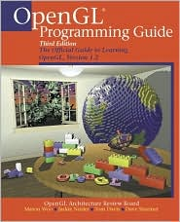
Required Textbook
OpenGL Programming Guide 8th Edition
7th Edition Available as PDF - http://www.opengl.org/documentation/red_book/

Slide 12
Slides
The slides will be available on blackboard and are intended for your personal studies
You are not allowed to distribute the slides
You are still expected to read the book for a better and more complete understanding of the topics in this class

Slide 13
Projects
The projects are the core of the course
It is important that you are able to implement computer graphics algorithms
The projects will have a clear specification
The TA will test your programs and ask a few questions about the code

Slide 14
Grades
A+ [97–100] A [93–96] A- [90-92]
B+ [87–89] B [83–87] B- [80–82]
C+ [77–79] C [70–77]
D [60-69]
E [0–60]
I might choose to improve the grades by lowering some cutoff values
I will definitely not increase the cutoff values
If there is a curve it will not be decided until all grades are in, if you ask, this is the scale I will refer to

Slide 15
Grades
Projects: 55%
Midterm: 20%
Final exam: 25%
Participation: up to -20% for lack of attendance, lack of participation, or disrupting the class (for severe cases only)

Slide 16
Workload
Arizona Board of Regents Suggests: 2-3 hours outside class for each hour in class!
That means 6-9 hours of work outside of class. If you miss the class you will need more time.

Slide 17
Missing an Exam
If you miss a mid-term or the final exam
If you have a very important reason not to be here we can certainly find a solution
You need written documentation(!) to state your case
You need to notify me as soon as possible
Any make up test will be more difficult

Slide 18
How Can I Improve My Grade?
There might be extra credit on the projects
There might be extra credit on the final or midterm
Please Note: It is unethical to bring to your instructor's attention the possible impact of your course grade on your future plans, including graduation, scholarships, jobs, etc.
https://provost.asu.edu/files/AcademicIntegrityPolicyPDF.pdf (See pg. 2 letter N for the above bullet)

Slide 19
Academic Integrity
Violations of academic integrity include (but are not limited to) cheating, fabrication, tampering, plagiarism or facilitating such activities.
I have a zero tolerance policy. Any perceived cheating will be sent to the provost and dismissal from the university will be recommended.

Slide 20
Academic Integrity
Cheating on Exams
Copying from another’s test paper.
Making a copy of a test and giving it to someone or using a test if someone gives it to you.
Using technology to take a test for someone or asking someone to take a test for you.
Inappropriate Collaboration
Working with others when you should be doing the work individually.

Slide 21
Classroom Behavior
No cell phones (No texting/facebooking/etc.)
No Food / Drinks (Drinks with appropriate lids are ok, but the first spilled drink will result in a class ban)
Participation is expected!

Slide 22
Attendance Policy
Attendance is required
Announcements are made in class
Announcements might not be on the web pages, but I will try to post all important information on myASU
If you come to class, you will be expected to participate
Your grade may suffer due to lack of attendance, random attendance may be taken to help assess participation

Slide 23
Disability Resource Center
Disability Resource Center for Academic Access: If you have a disability that will require accommodation in this class, please schedule an appointment or see me during office hours to discuss your accommodation request.
Note: To qualify for disability accommodations here at ASU, students must register and qualify for services through the Disability Resource Center for Academic Access and Achievement (DRC) located on the 1st Floor of Matthews Center, Room 143, 480-965-1234 (V), 480-965-9000 (TTY).

Slide 24
Method of Instruction
The goal is to begin programming graphics as soon as possible
You have to be able to
understand the theory (midterm, final)
and implement the theory in practice (projects)
The focus of your learning experience will be the projects

Slide 25
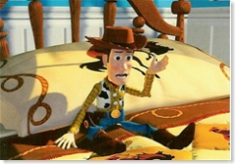
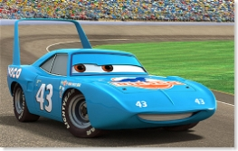
Class Participation Time
Introduce yourself to your neighbor!
© Pixar
On 1995 computer hardware, the average frame of Toy Story took two hours to render.
A decade later on 2005 hardware, the average Cars frame took how many hours to render?
15 hours, despite a 300x overall increase in compute power.
The artists have an essentially infinite appetite for detail and realism, and Pixar's resources have grown over the decade so it can afford to allocate more computers to the task, allowing each to run longer to achieve the artist’s vision for the scene.

Slide 26
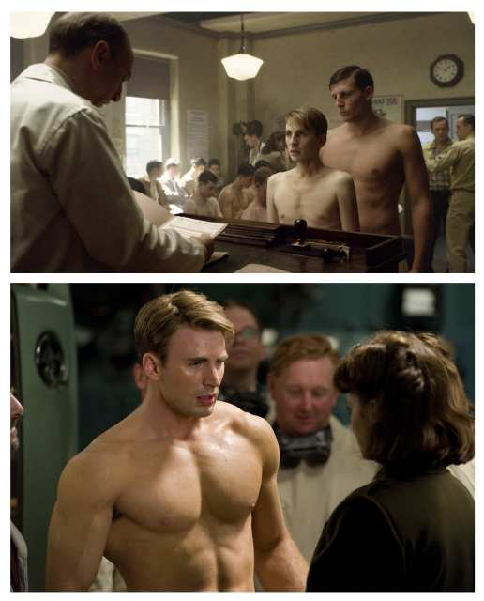
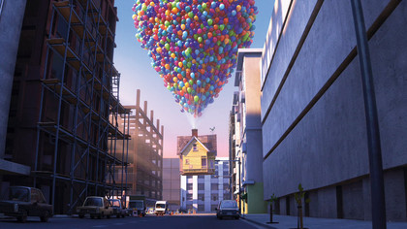
Current Computer Graphics
© Pixar
Publicity photos from "Captain America: The First Avenger." The film's makers used a computer "shrinking" technique to erase portions of Evans' strong physique onscreen
Created a physics engine to simulate the interaction of 10,000+ balloons emerging from the house.

Slide 27
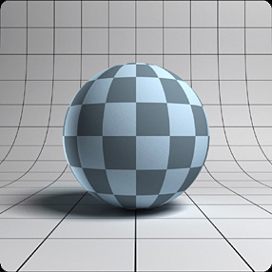
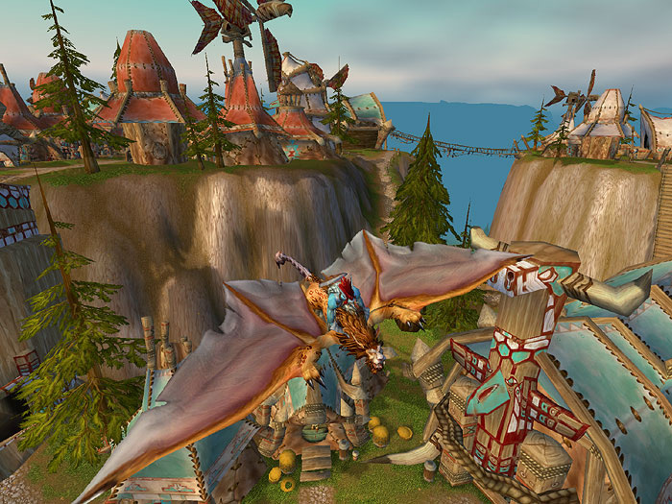
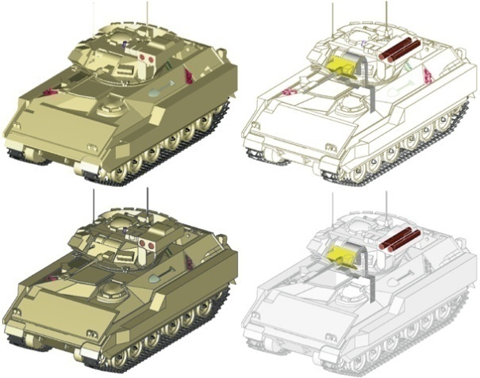
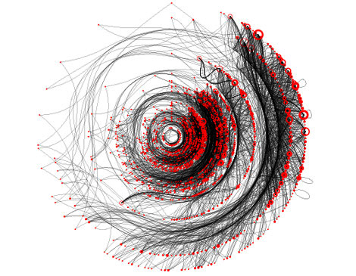
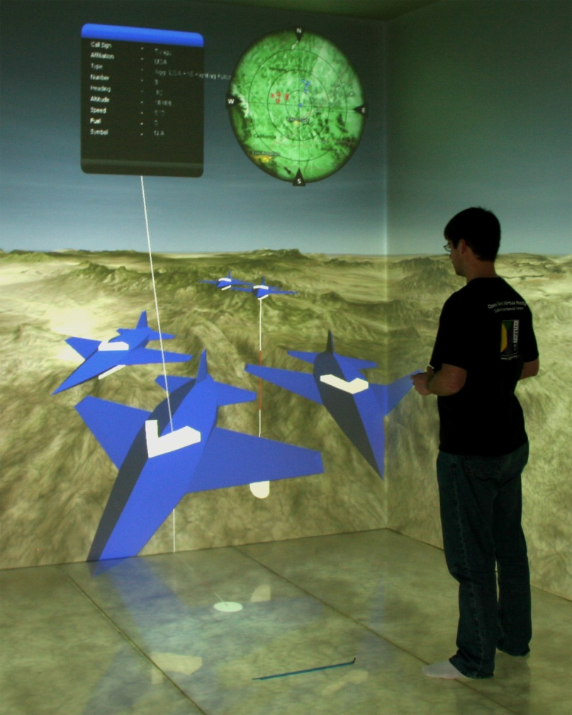
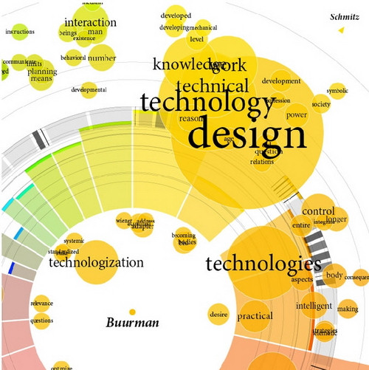
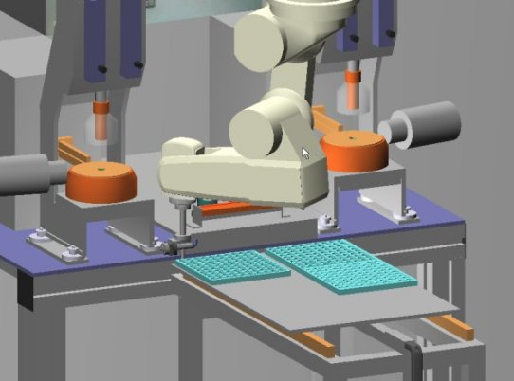

Slide 28
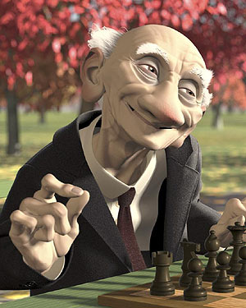
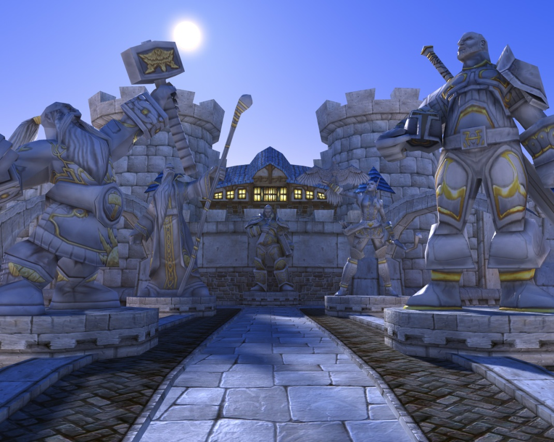
Entertainment

Slide 29
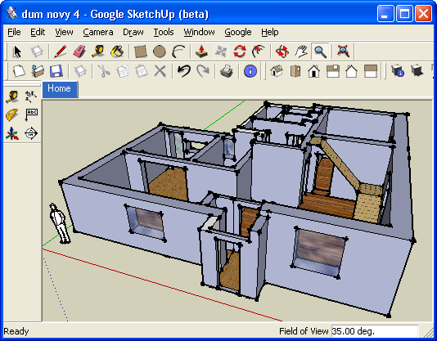
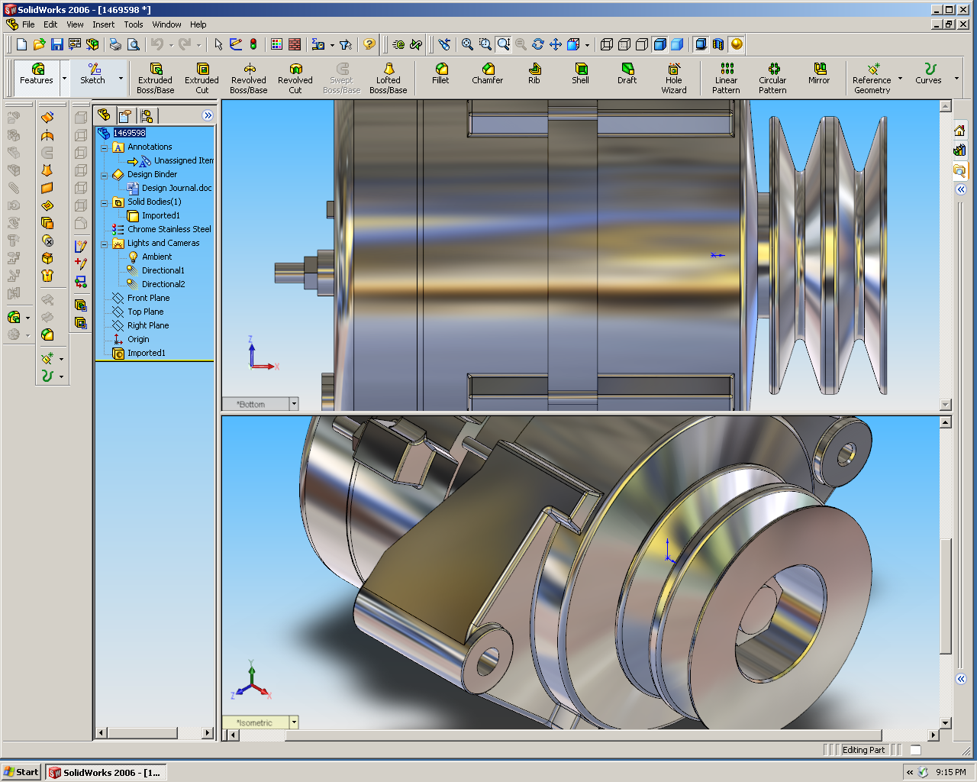
Design

Slide 30
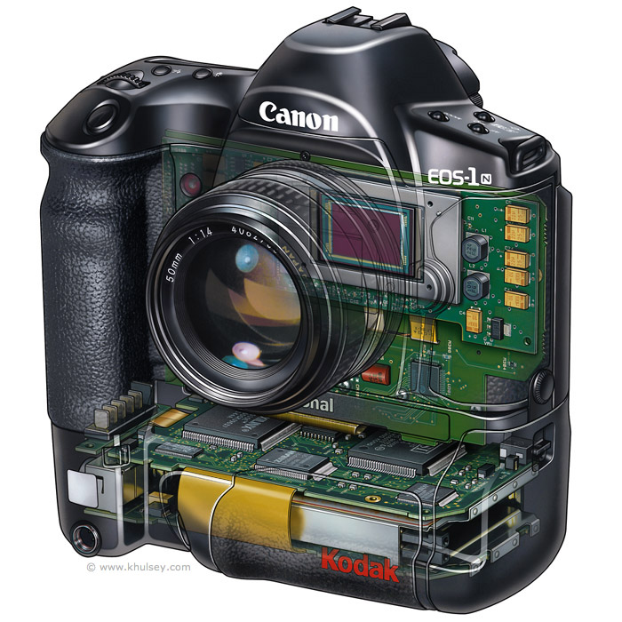

Digital Photography

Slide 31
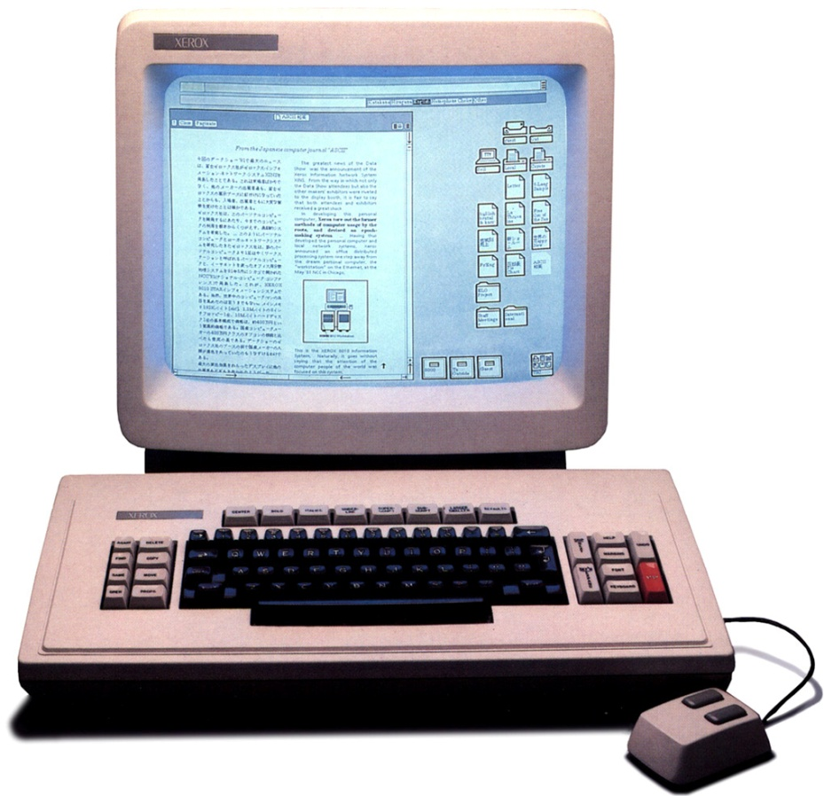
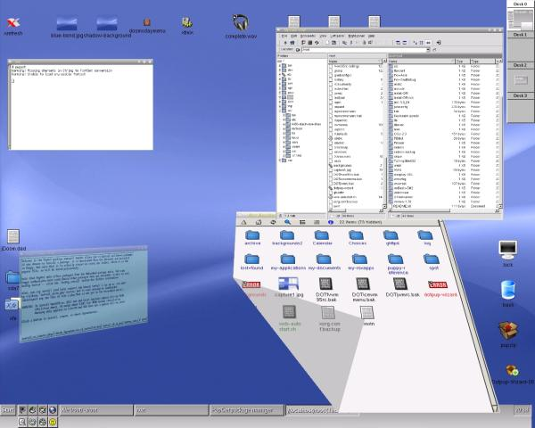
User Interfaces

Slide 32
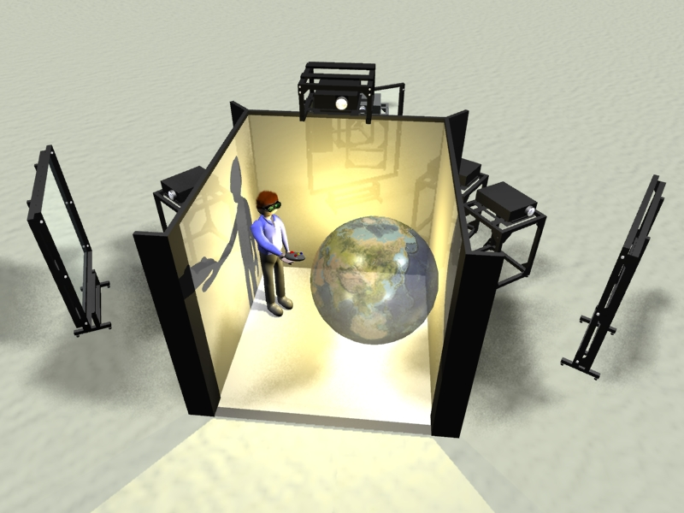
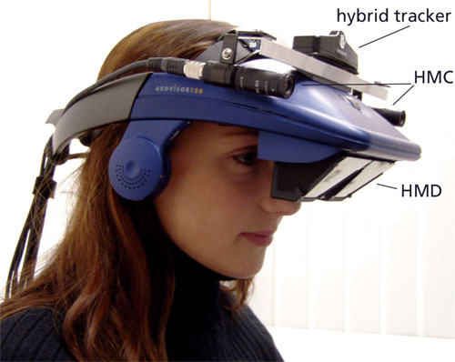
Virtual Reality

Slide 33
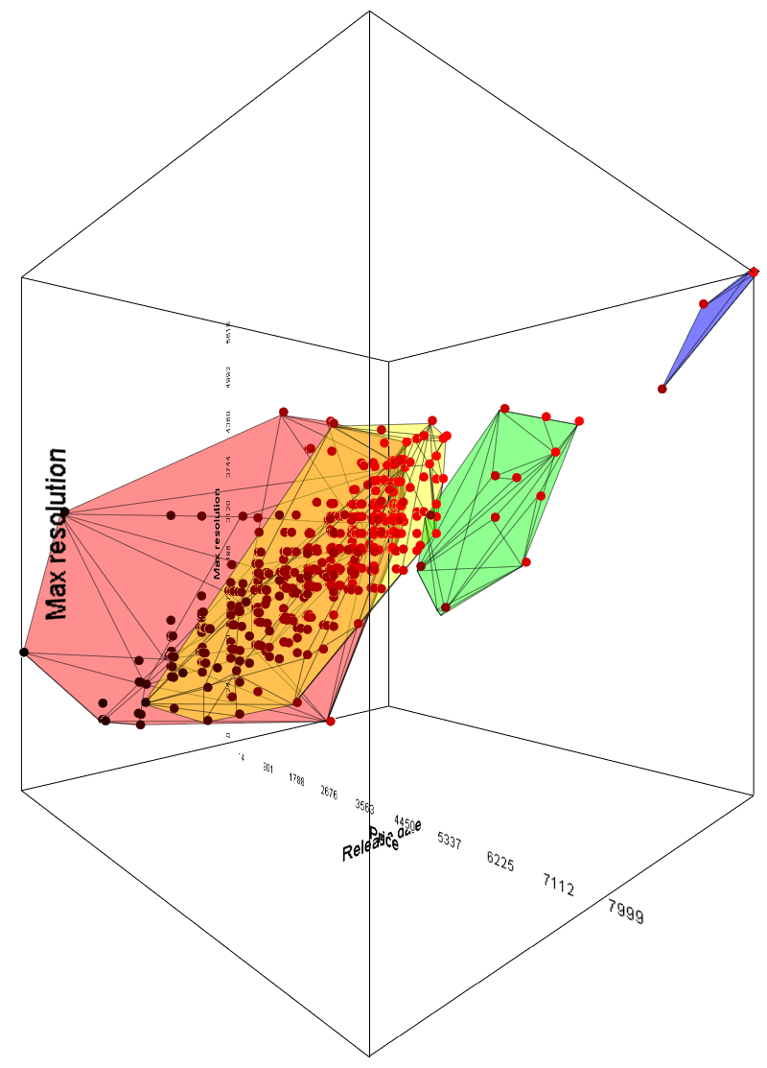
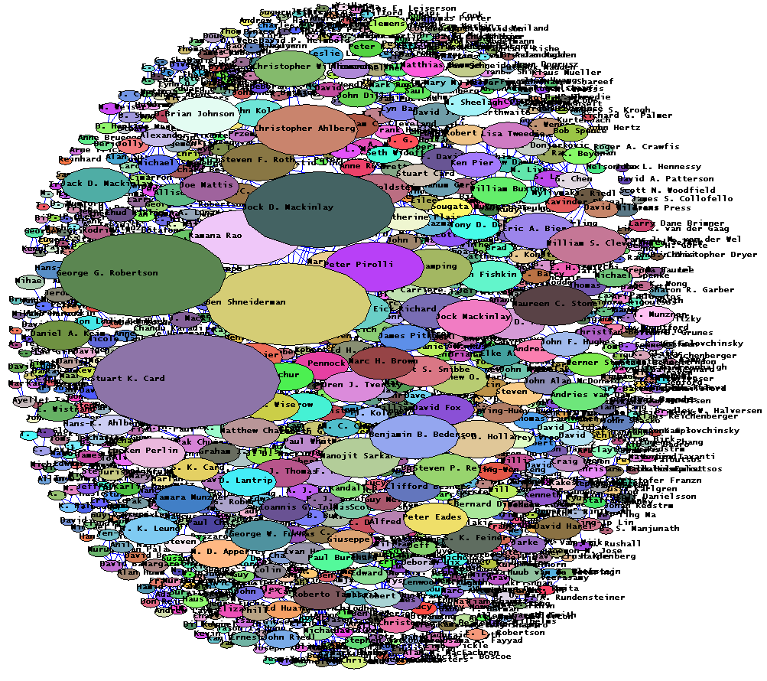
Visualization

Slide 34
Prerequisites
Programming Skills
C++
Ability to write medium size programs
Algorithms / Linear Algebra
If you have problems with the math part you need to come talk to me

Slide 35
How difficult will this course be?
It all depends on your background
We will be implementing algorithms
We will be doing linear algebra
We will be programming in C++

Slide 36
Design an Algorithm
Given a viewpoint in 3D (x_{v},y_{v},z_{v})
Given a sphere with
Center - (x_{s}, y_{s}, z_{s})
Radius - r
Give a pseudo-code of an algorithm that tests if the viewpoint is inside the sphere.

Slide 37
Design an Algorithm
Bool TestIntersection(x_{v}, y_{v}, z_{v}, x_{s}, y_{s}, z_{s}, r)
{
float h;
h = (x_{v} – x_{s}) * (x_{v} – x_{s}) +
(y_{v} – y_{s}) * (y_{v} – y_{s}) +
(z_{v} – z_{s}) * (z_{v} – z_{s});
if ( h > r*r) return false;
return true;
}

Slide 38
Linear Algebra
Compute x

Slide 39
Linear Algebra

Slide 40
Transformations
How do we rotate a point (P) by θ degrees?
We need to know the rotation matrix
Then, we multiply the current point (P) by the rotation matrix to find the new rotated coordinate.
⎛
cos θ
−sin θ
⎞
⎛
x
⎞
R
=
⎜
⎟
P
=
⎜
⎟
⎝
sin θ
cos θ
⎠
⎝
y
⎠
⎛
cos θ
−sin θ
⎞
⎛
x
⎞
P
′
=
R
⋅
P
=
⎜
⎟
⎜
⎟
⎝
sin θ
cos θ
⎠
⎝
y
⎠

Slide 41
Transformations
⎛
cos θ
−sin θ
⎞
⎛
x
⎞
P
′
=
R
⋅
P
=
⎜
⎟
⎜
⎟
⎝
sin θ
cos θ
⎠
⎝
y
⎠
⎛
x
cos
θ
−
y
sin
θ
⎞
=
⎜
⎟
⎝
x
sin
θ
+
y
cos
θ
⎠

Slide 42
Geometric test
Given a line 7x + 3y = 0
How can you test if a point is on the left or right side of the line?
Can you draw the line on a piece of paper?

Slide 43
Programming
void init (void)
{
glClearColor (1.0, 1.0, 1.0, 0.0); // Set display-window color to white.
glMatrixMode (GL_PROJECTION); // Set projection parameters.
gluOrtho2D (0.0, 200.0, 0.0, 150.0);
}
void lineSegment (void)
{
glClear (GL_COLOR_BUFFER_BIT); // Clear display window.
glColor3f (0.0, 0.0, 1.0); // Set line segment color to blue.
glBegin (GL_LINES);
glVertex2i (180, 15); // Specify line-segment geometry.
glVertex2i (10, 145);
glEnd ( );
glFlush ( ); // Process all OpenGL routines as quickly as possible.
}

Slide 44
What will we cover in class?
Computer graphics deals with algorithms to create images with the computer.
Computer games
Motion pictures
Scientific simulations
What will we study?
Start with algorithms for simple 2D problems (Chapter 2)
Draw a line
Draw a circle
Draw a triangle on the screen

Slide 45
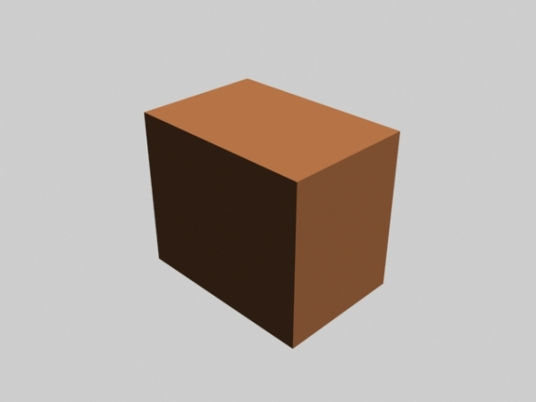
What will we cover in class?
Using these simple algorithms we will move to 3D graphics
Describe a three-dimensional scene (world)
Simulate a camera to take an image of that scene
A 3D example
Consider a box in 3D space
A 3D box has 6 sides and can be broken into 12 triangles
Each vertex of the box is described by three coordinates (x, y, z)
Vertex

Slide 46
What will we cover in class?
To create a 2D image of the 3D box we have to project the box onto a plane
This will require some simple linear algebra
We will study these foundations of computer graphics and derive the algorithms for projecting general objects on the screen (Chapter 3)

Slide 47
What will we cover in class?
A box is only a very simple example
We will study how to represent more complex three dimensional objects, such as curved surfaces
To make the simulation more convincing we will need some simple physical simulation, to compute how light from a light source would interact with the surface material of an object
For many applications we will want a real-time simulation and not only static images
We will study geometric transformations, to be able to move objects in space
Other topics will be covered too

Slide 48
Skills you will take away
Theoretical foundations of computer graphics
Hands-on experience at developing interactive, real-time rendering applications using OpenGL
This course covers the theory within the OpenGL API
The tools you develop in this course will open up a whole new world of 3D visualization for you!

Slide 49
Course Outcomes
Understanding of the design issues for creating graphics
Ability to apply rendering techniques to an actual computer graphics problem and associated datasets
Basic knowledge of OpenGL
Understanding of the mathematical foundations of graphics
Object representations
Transformations
Projections
Understanding of color, illumination, and shading
Understanding of rendering and rasterization techniques
Raytracing
Polygonal rendering
Understanding of some applications of computer graphics
Visualization, animation, computer aided design, Virtual Reality, computer games, etc

Slide 50
What you won’t learn in this course
This course does not focus on design aspects:
How to use photoshop to create great webpages or posters
How to paint interesting textures
How to design logos
How to create 3D models with professional modeling software
These topics are covered in other courses, typically not Computer Science

Slide 51
Questions?
Ask now or e-mail later
Acknowledgements
Previous instructors of CS 470/CS 595
Peter Wonka, CS
Previous instructors at Purdue
David Ebert, ECE
Niklas Elmqvist, ECE
Instructors at other universities
Chuck Hansen, University of Utah
Hank Childs, University of Oregon
Google Image Search
Copyright respective owners

Slide 52
What is Computer Graphics?
Ross Maciejewski
Assistant Professor Computer Science Arizona State University

Slide 53
Computer Graphics
Computer graphics deals with all aspects of creating images with a computer
Hardware
Software
Applications
Example from textbook

Slide 54

Example
Where did this image come from?
What hardware/software did we need to produce it?

Slide 55
Preliminary Answer
Application: The object is an artist’s rendition of the sun for an animation to be shown in a domed environment (planetarium)
Software: Maya for modeling and rendering but Maya is built on top of OpenGL
Hardware: PC with graphics card for modeling and rendering

Slide 56
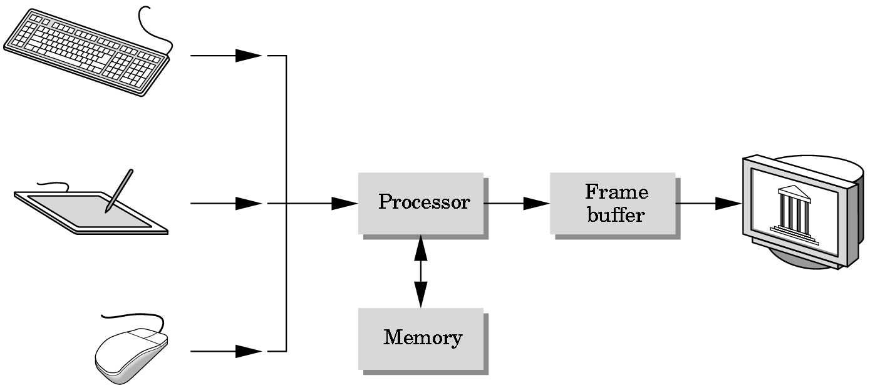
Basic Graphics System
Output device
Input devices
Image formed in FB

Slide 57
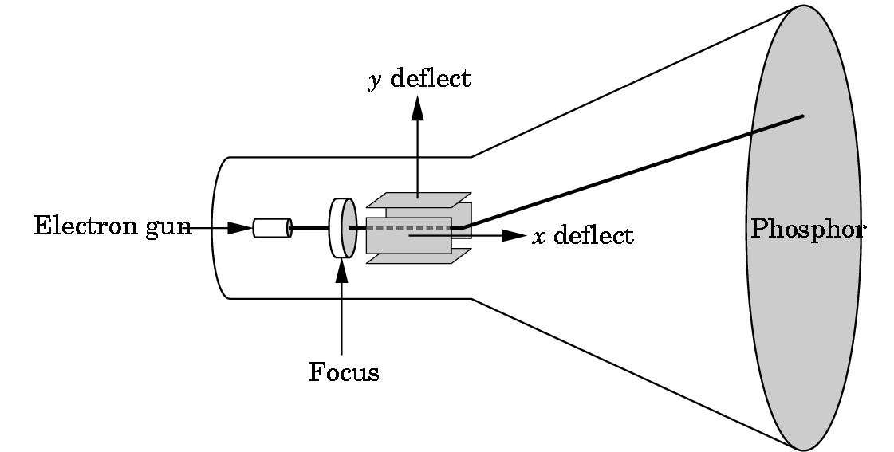
CRT
Can be used either as a line-drawing device (calligraphic) or to display contents of frame buffer (raster mode)

Slide 58
History: 1950-1960
Computer graphics goes back to the earliest days of computing
Strip charts
Pen plotters
Simple displays using A/D converters to go from computer to calligraphic CRT
Like standard screens, but no refresh…
Cost of refresh for CRT too high
Computers slow, expensive, unreliable

Slide 59
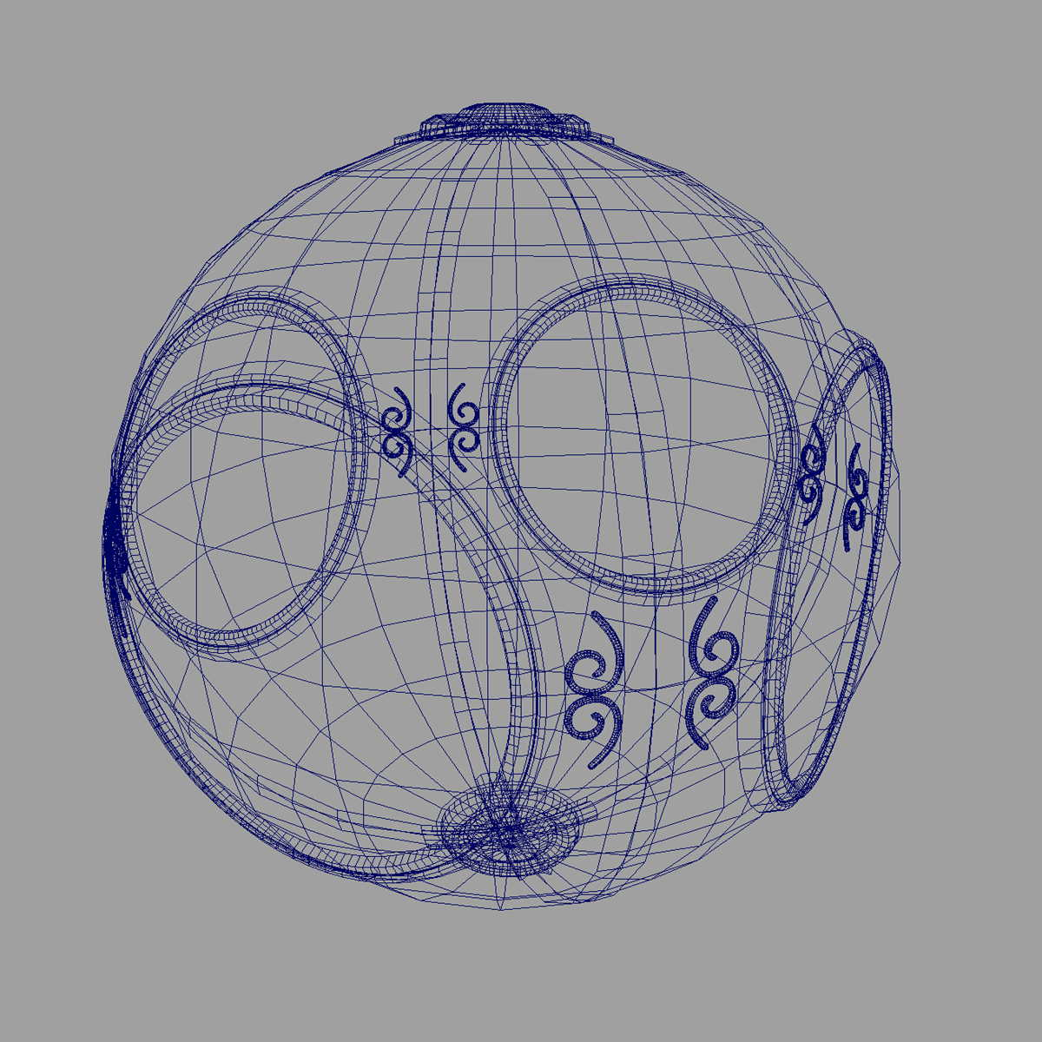
History: 1960-1970
Wireframe graphics
Aka vector graphics
Draw only lines
Sketchpad
Display Processors
Storage tube
wireframe representation
of sun object

Slide 60
Sketchpad
Ivan Sutherland’s Ph.D. thesis at MIT
Recognized the potential of man-machine interaction
Loop
Display something
User moves light pen
Computer generates new display
Sutherland also created many of the now common algorithms for computer graphics

Slide 61
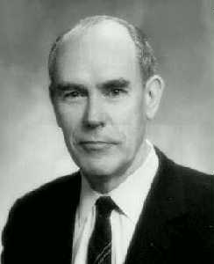
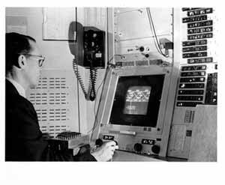
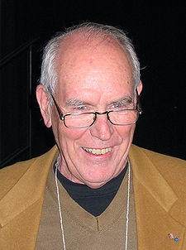
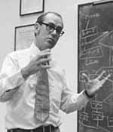
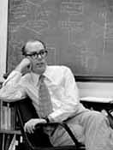
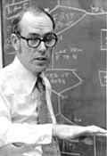
Ivan Sutherland (b. 1938-)
“A display connected to a digital computer gives us a chance to gain familiarity with concepts not realizable in the physical world. It is a looking glass into a mathematical wonderland.”

Slide 62
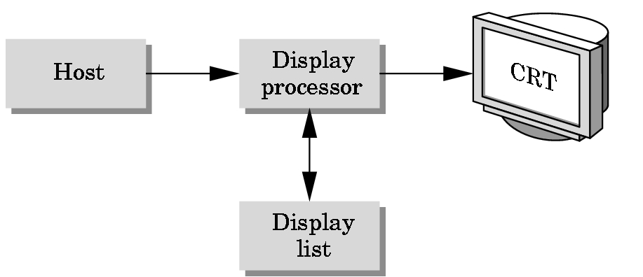
Display Processor
Rather than have the host computer try to refresh display use a special purpose computer called a display processor (DPU)
Graphics stored in display list (display file) on display processor
Host compiles display list and sends to DPU

Slide 63
Direct View Storage Tube
Created by Tektronix
Did not require constant refresh
Standard interface to computers
Allowed for standard software
Plot3D in Fortran
Relatively inexpensive
Opened door to use of computer graphics for CAD community

Slide 64
History: 1970-1980
Raster Graphics
Beginning of graphics standards
IFIPS
GKS: European effort
Low-level 2D vector graphics suitable for charting
Becomes ISO 2D standard
Core: North American effort
3D but fails to become ISO standard
Workstations and PCs

Slide 65
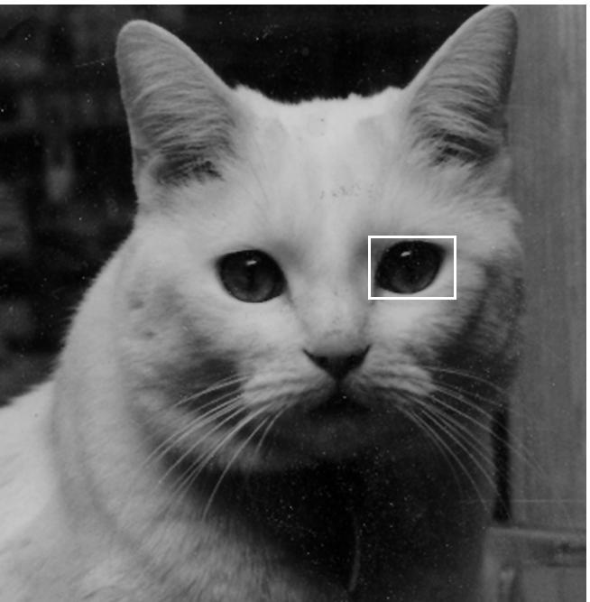
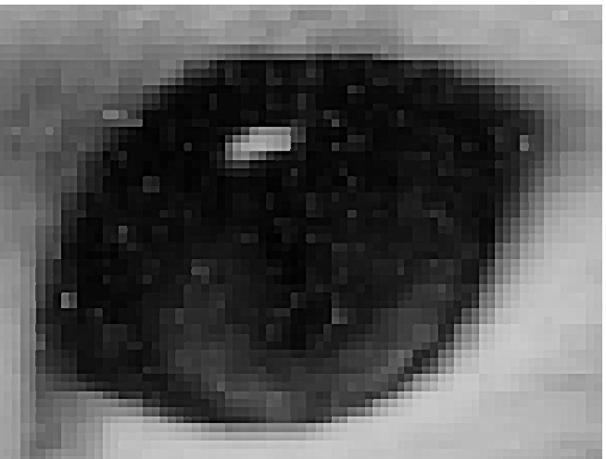
Raster Graphics
Image produced as an array (the raster) of picture elements (pixels) in the frame buffer

Slide 66
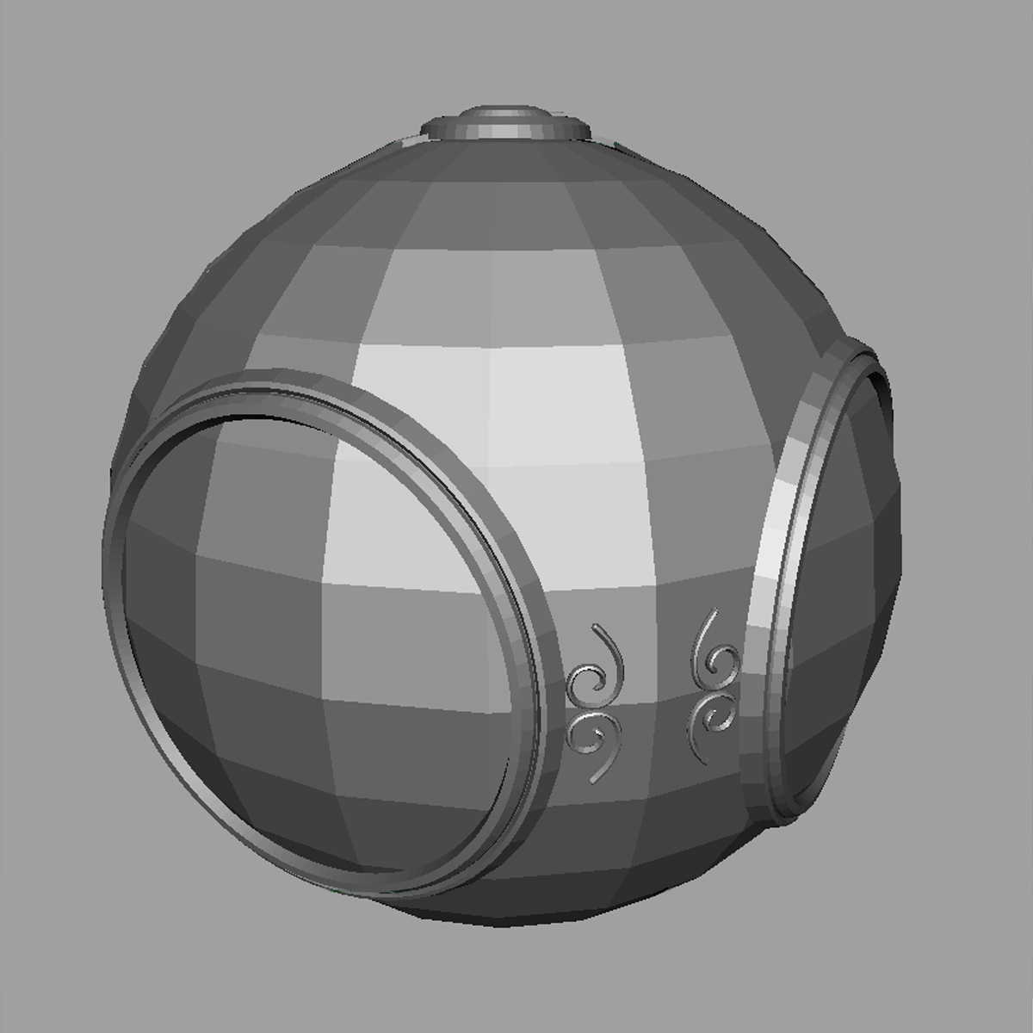
Raster Graphics
Allows us to go from lines and wire frame images to filled polygons

Slide 67
PCs and Workstations
Although we no longer make the distinction between workstations and PCs, historically they evolved from different roots
Early workstations characterized by
Networked connection: client-server model
High-level of interactivity
Early PCs included frame buffer as part of user memory
Easy to change contents and create images

Slide 68
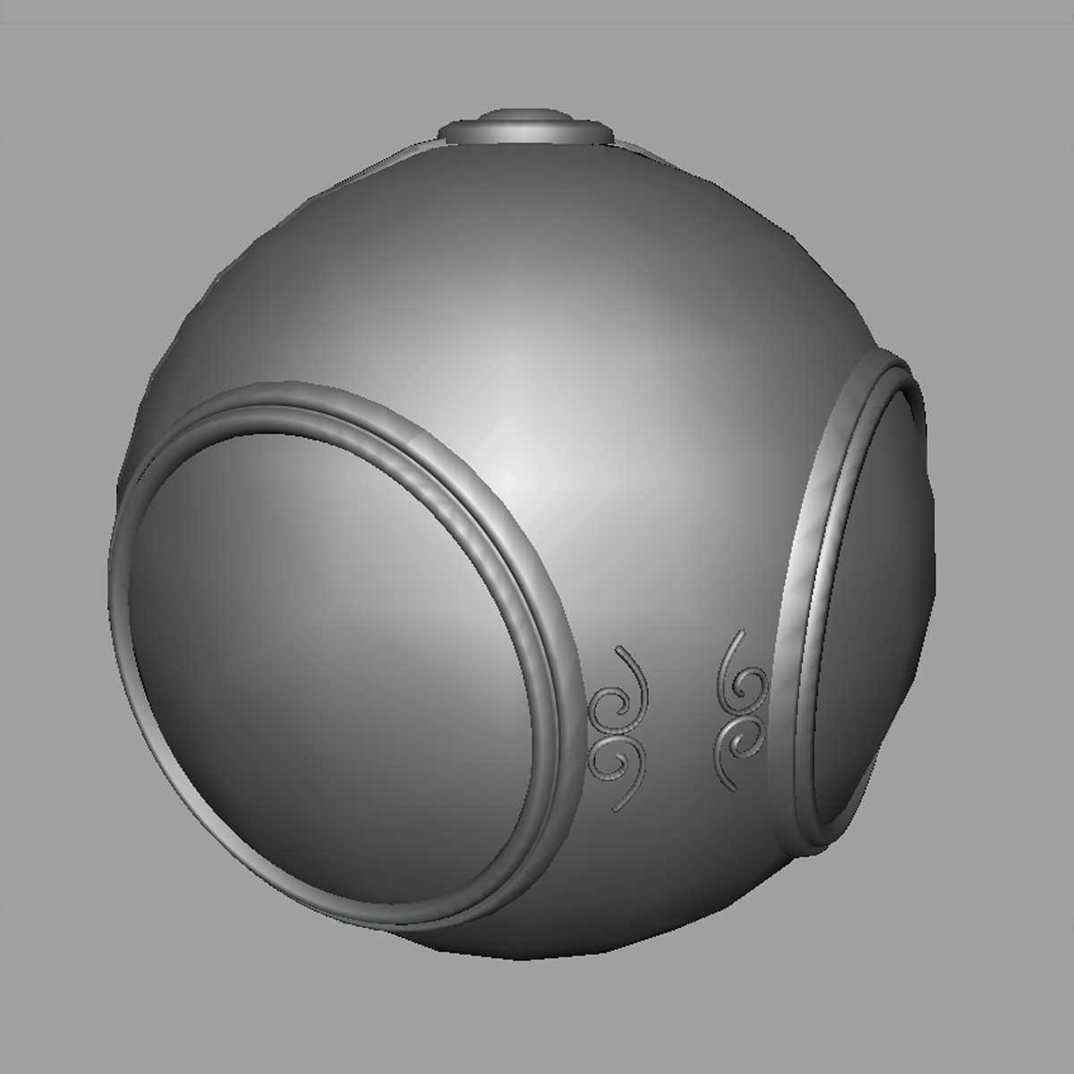
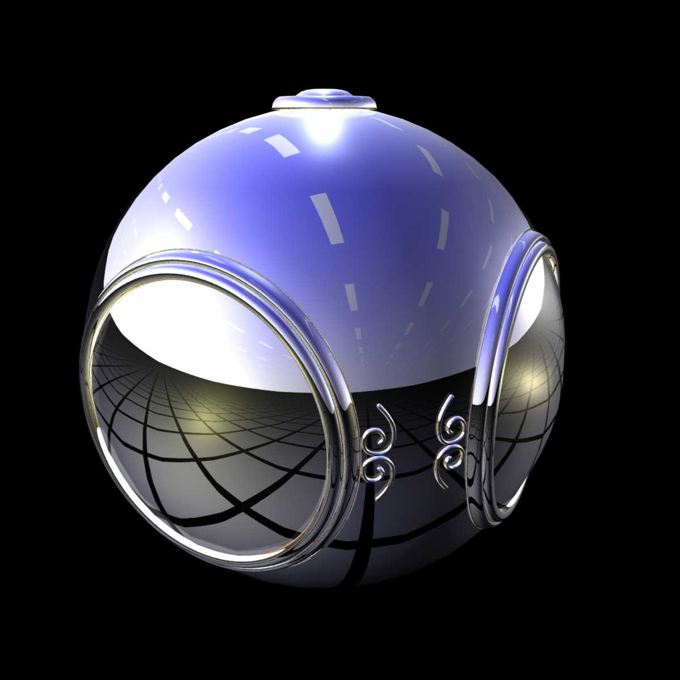
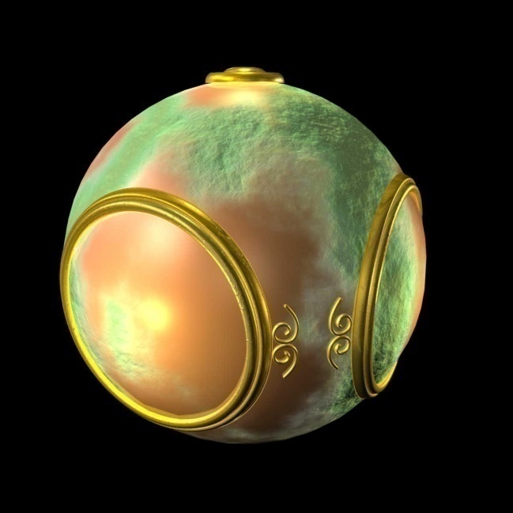
History: 1980-1990
Realism comes to computer graphics
smooth shading
environment
mapping
bump mapping

Slide 69
History: 1980-1990
Special purpose hardware
Silicon Graphics geometry engine
VLSI implementation of graphics pipeline
Industry-based standards
PHIGS – descendant of GKS
3D graphics standard for the 90s
Scene graph hierarchy part of standard
RenderMan
Pixar
Networked graphics: X Window System
Human-Computer Interaction (HCI)

Slide 70
History: 1990-2000
OpenGL API
Completely computer-generated feature-length movies (Toy Story) are successful
New hardware capabilities
Texture mapping
Blending
Accumulation, stencil buffers
Non-photorealistic rendering (NPR)

Slide 71
RenderMan
3D scene specification
Off-line rendering (cf. real-time for OpenGL)
Interface protocol for different 3D apps
Developed by Pixar Animation Studios
Like PostScript for 3D
Components
High-level geometric primitives
Quadrics, bicubic patches, etc
Shading language (RSL)
C-like syntax, compare to GLSL (later lectures)

Slide 72
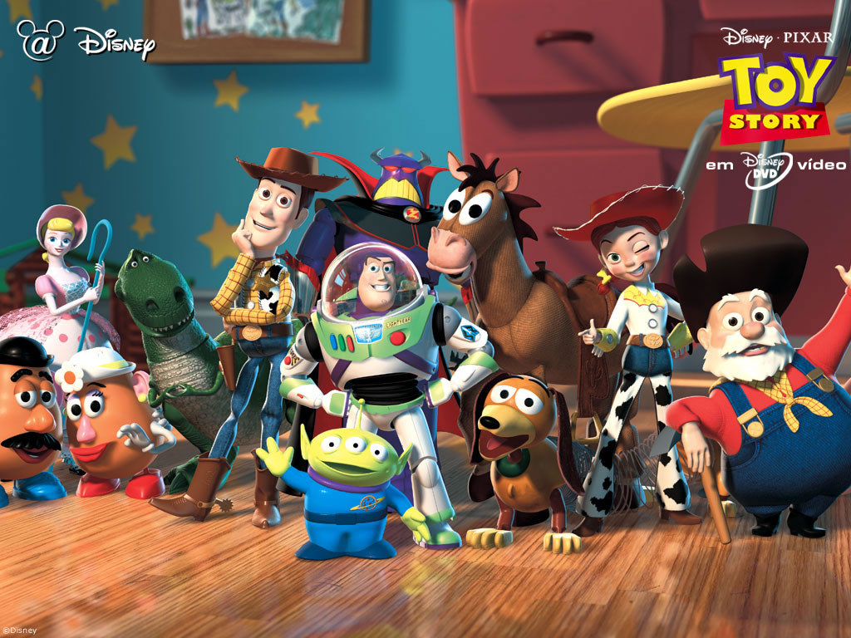

Slide 73
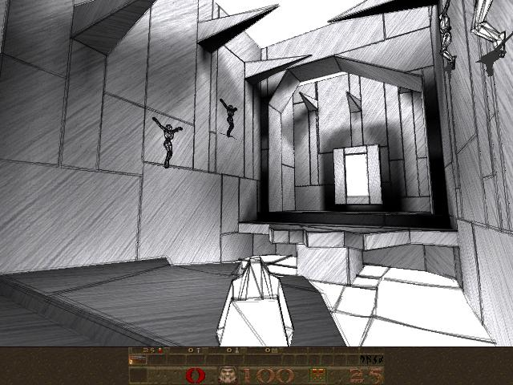


NPR

Slide 74
History: 2000-
Photorealism
Graphics cards for PCs dominate market
NVidia, ATI
Game boxes and game players determine direction of market
Computer graphics routine in movie industry: Maya, Lightwave
Programmable pipelines

Slide 75
Questions?
Acknowledgements
Previous instructors of CSE 470/598
Peter Wonka, CS
Purdue Colleagues
David Ebert, ECE
Niklas Elmqvist, ECE
Slides (Ed Angel)

